Slide 1
AI6124 Project Stock Market Prediction
Sean Goh Ann Ray
G2202190G

Slide 2
Content
Dataset
Hybrid AI Method
Benchmark Method
Jupyter Notebook Code
Results

Slide 3

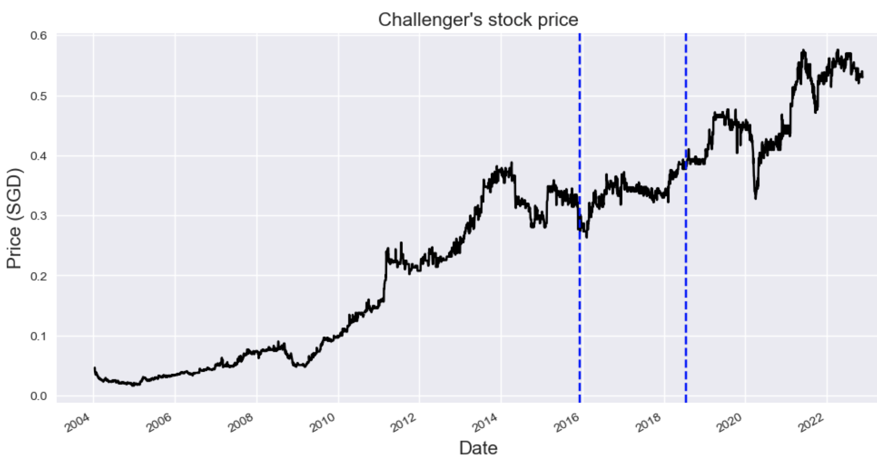
Dataset: Challenger
Singapore company (573.SI)
Varying pattern
60/15/25 split
C(T+1)
Input Label
d(T)
C(T)
d(T-1)
C(T-1)
Input Features
d(T-2)
C(T-2)
d(T-3)
>4300 Datapoints
C(T-3)
Logo Source: https://www.challenger.sg

Slide 4
Hybrid AI Method: DENFIS
Dynamic Evolving Neural Fuzzy Inference System
Input
Layer
Fuzzy
Layer
Rule-Firing
Layer
Normalize
Layer
Consequent
Layer
Output
Layer
A₁
A
A₂
∏₁
N₁
C₁
B₁
∑
B
Y
B₂
∏₂
N₂
C₂
C₁
C
C₂
Source: Nikola K. and Qun Song, “DENFIS: Dynamic Evolving Neural-Fuzzy Inference System and Its Application for Time-Series Prediction”

Slide 5
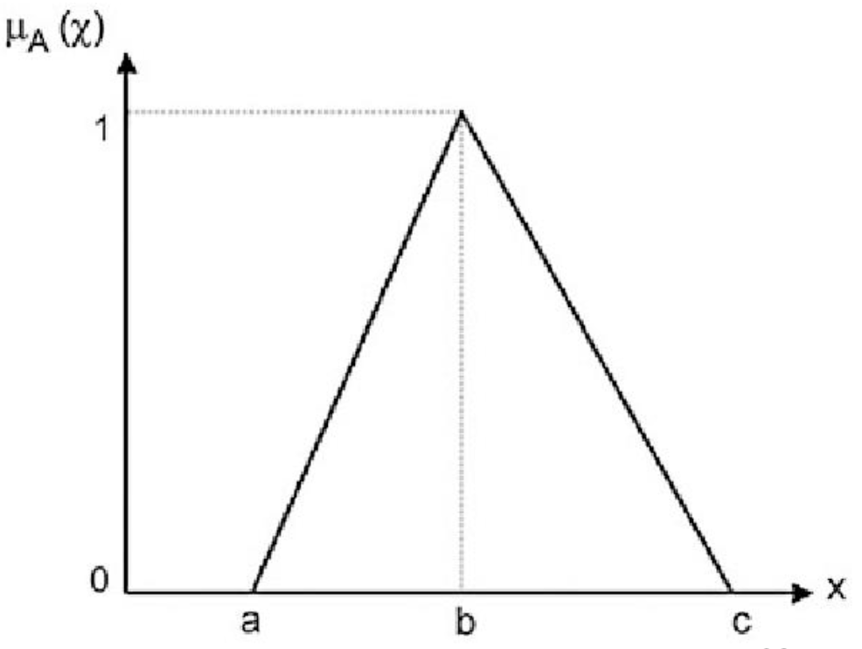
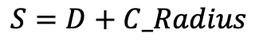
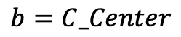
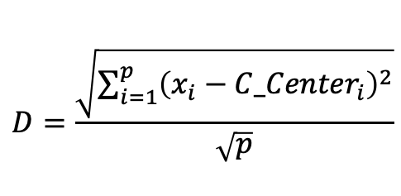
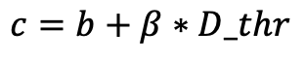
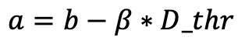
Hybrid AI Method: DENFIS
$$b=C_Center$$
$$a=b−β∗D_thr$$
$$c=b+β∗D_thr$$
Evolving Clustering Method to generate membership functions
One parameter
D_thr
If D < C_Radius
Merge into nearest C
If S > 2*D_thr
Create new C
Merge into nearest C
Update C_Radius
Update C_Center
1
Datapoint | x₁ | x₂
1 | 0.3 | 0.2
2 | 0.5 | 0.3
3 | 0.6 | 0.5
4 | 0.2 | 0.6
5 | 0.8 | 0.2
6 | 0.5 | 0.8
7 | 0.2 | 0.5
8 | 0.2 | 0.2
9 | 0.4 | 0.2
10 | 0.9 | 0.4
$$D=\frac{\sqrt{\sum_{i=1}^{p}{{\left(x_{i}−{C_Center}_{i}\right)}^{2}}}}{\sqrt{p}}$$
C₂
x₂
$$S=D+C_Radius$$
C₄
C₁
C₃
0
x₁
1

Slide 6
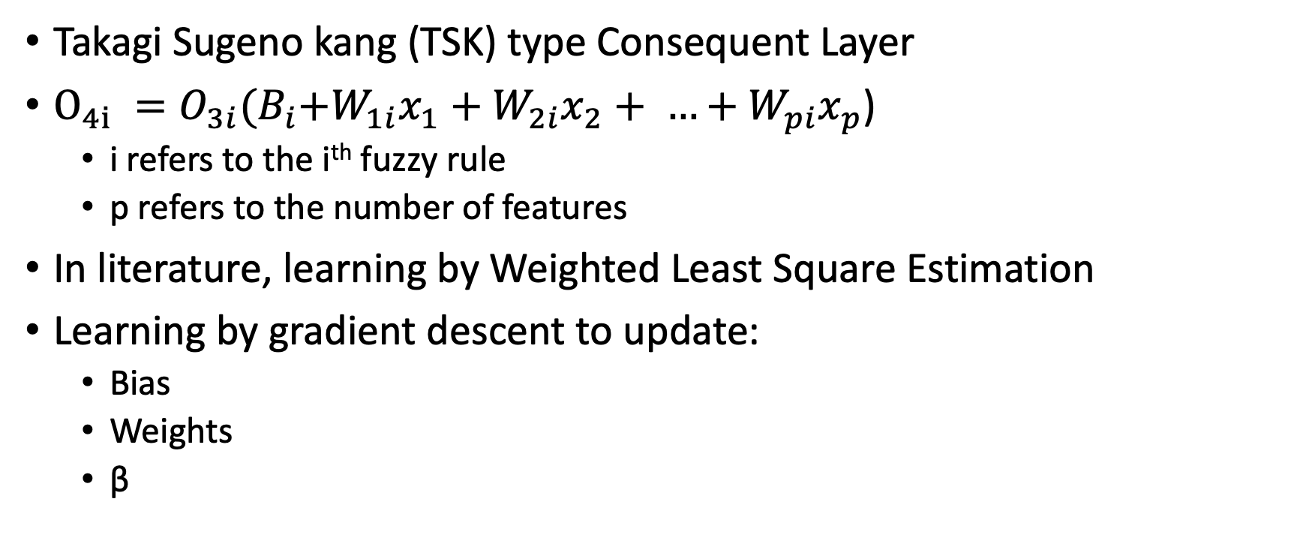
Hybrid AI Method: DENFIS
Takagi Sugeno kang (TSK) type Consequent Layer
$O_{4i} =O_{3i}{(B}_{i}+W_{1i}x_{1}+W_{2i}x_{2}+ …+W_{pi}x_{p}$)
i refers to the i^{th} fuzzy rule
p refers to the number of features
In literature, learning by Weighted Least Square Estimation
Learning by gradient descent to update:
Bias
Weights
β
Consequent Layer
Fuzzy Layer

Slide 7
Benchmark Method: ANFIS
Adaptive Network-based Fuzzy Inference System
Input
Layer
Fuzzy
Layer
Rule-Firing
Layer
Normalize
Layer
Consequent
Layer
Output
Layer
A₁
∏₁
N₁
A
C₁
A₂
B₁
∏₂
N₂
∑
B
C₂
Y
B₂
…
…
…
C₁
C
∏₈
N₈
C₈
C₂
Source: R Jang, “ANFIS: Adaptive Network-based Fuzzy Inference System”

Slide 8
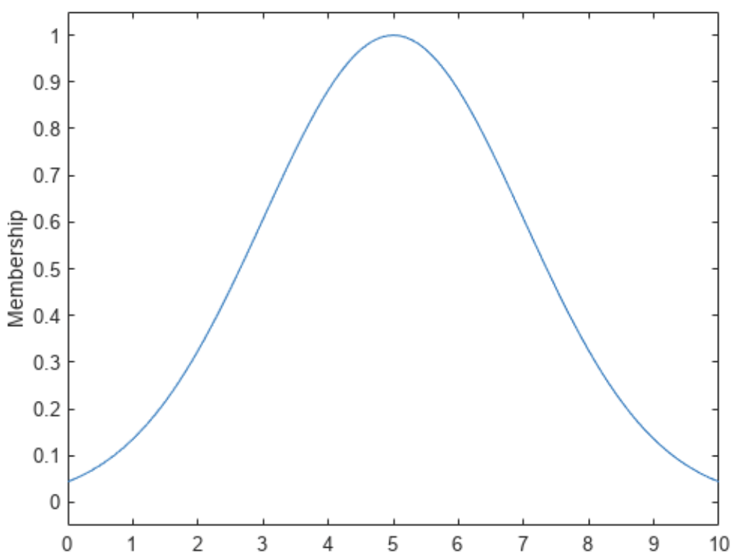
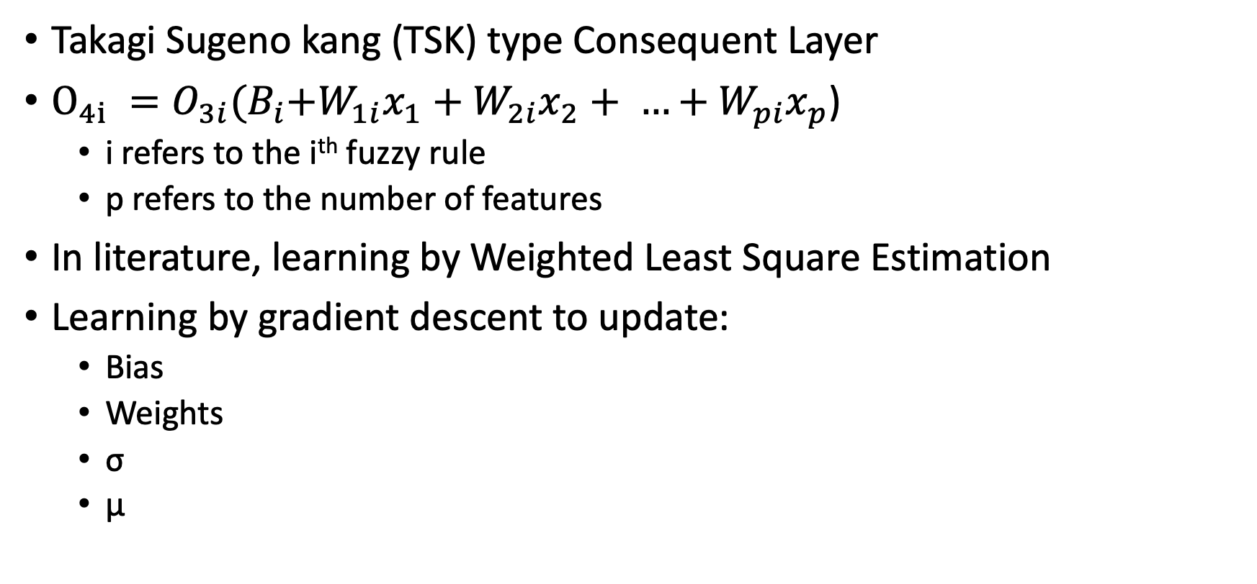
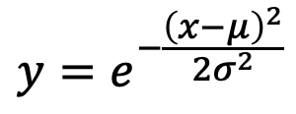
Benchmark Method: ANFIS
Takagi Sugeno kang (TSK) type Consequent Layer
$O_{4i} =O_{3i}{(B}_{i}+W_{1i}x_{1}+W_{2i}x_{2}+ …+W_{pi}x_{p}$)
i refers to the i^{th} fuzzy rule
p refers to the number of features
In literature, learning by Weighted Least Square Estimation
Learning by gradient descent to update:
Bias
Weights
σ
µ
Consequent Layer
$$y=e^{−\frac{{\left(x−μ\right)}^{2}}{2σ^{2}}}$$
Fuzzy Layer (Gaussian FMF)

Slide 9
Jupyter Notebook Code

Slide 10
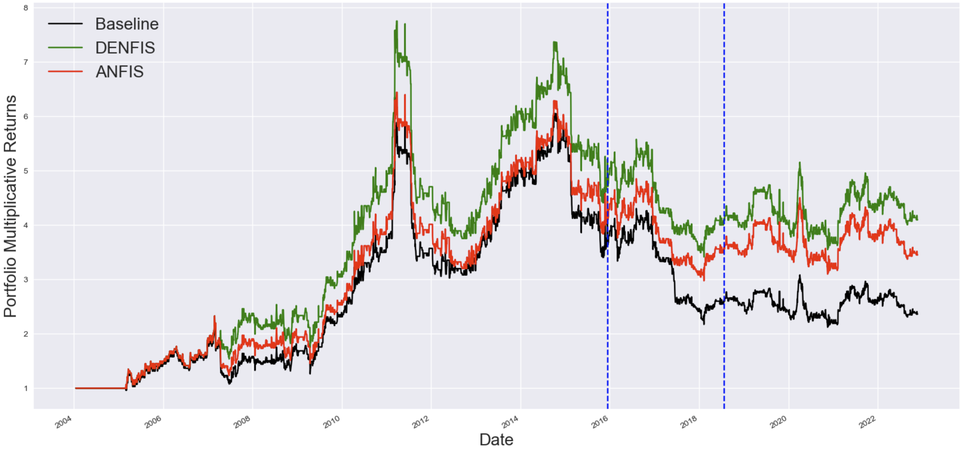
Results

Slide 11
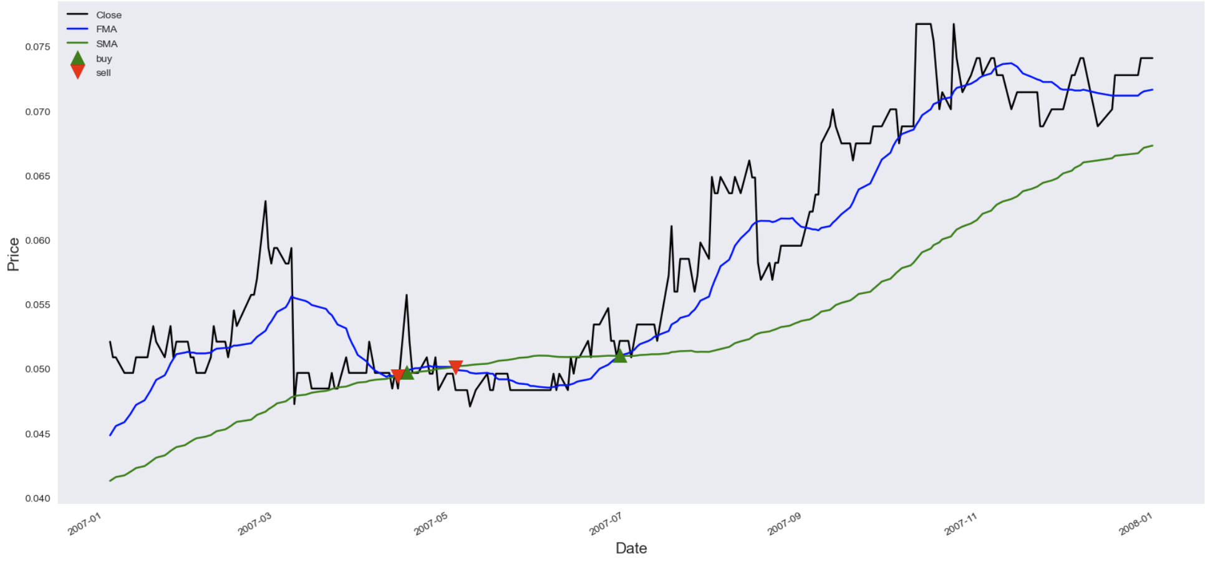
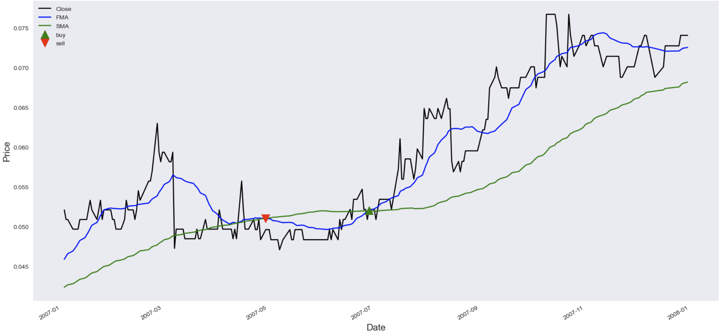
Results
Without Prediction
DENFIS Prediction

Slide 12
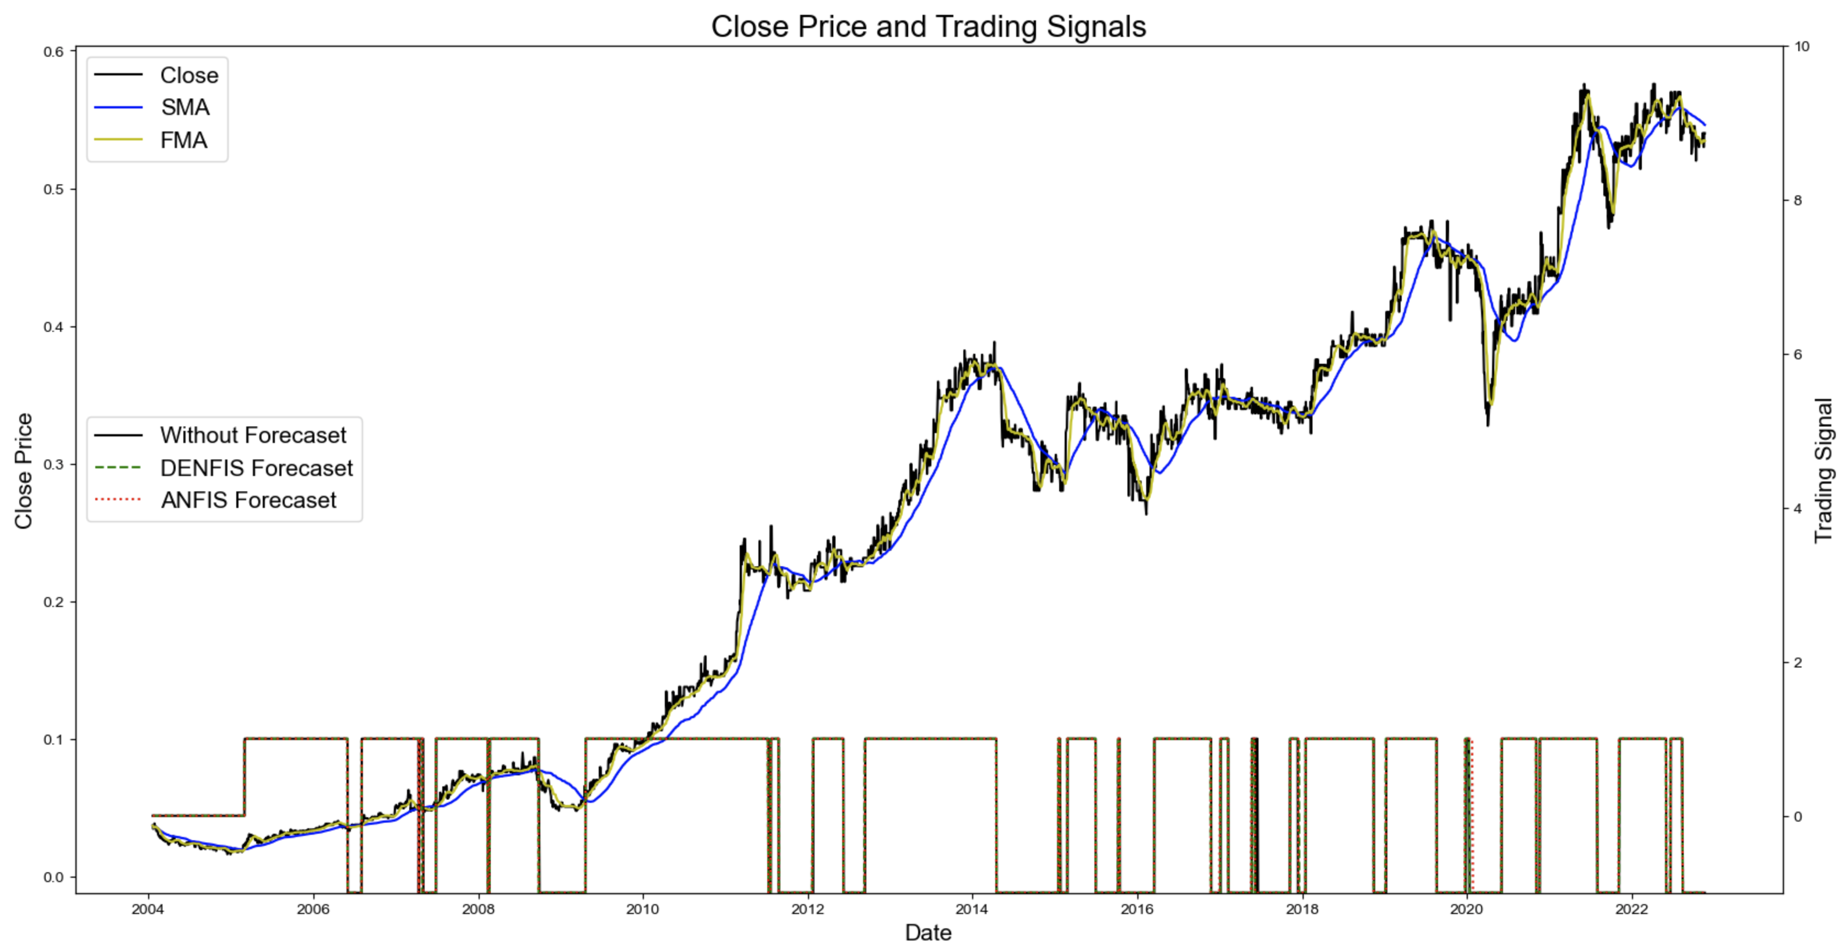
Results

Slide 13
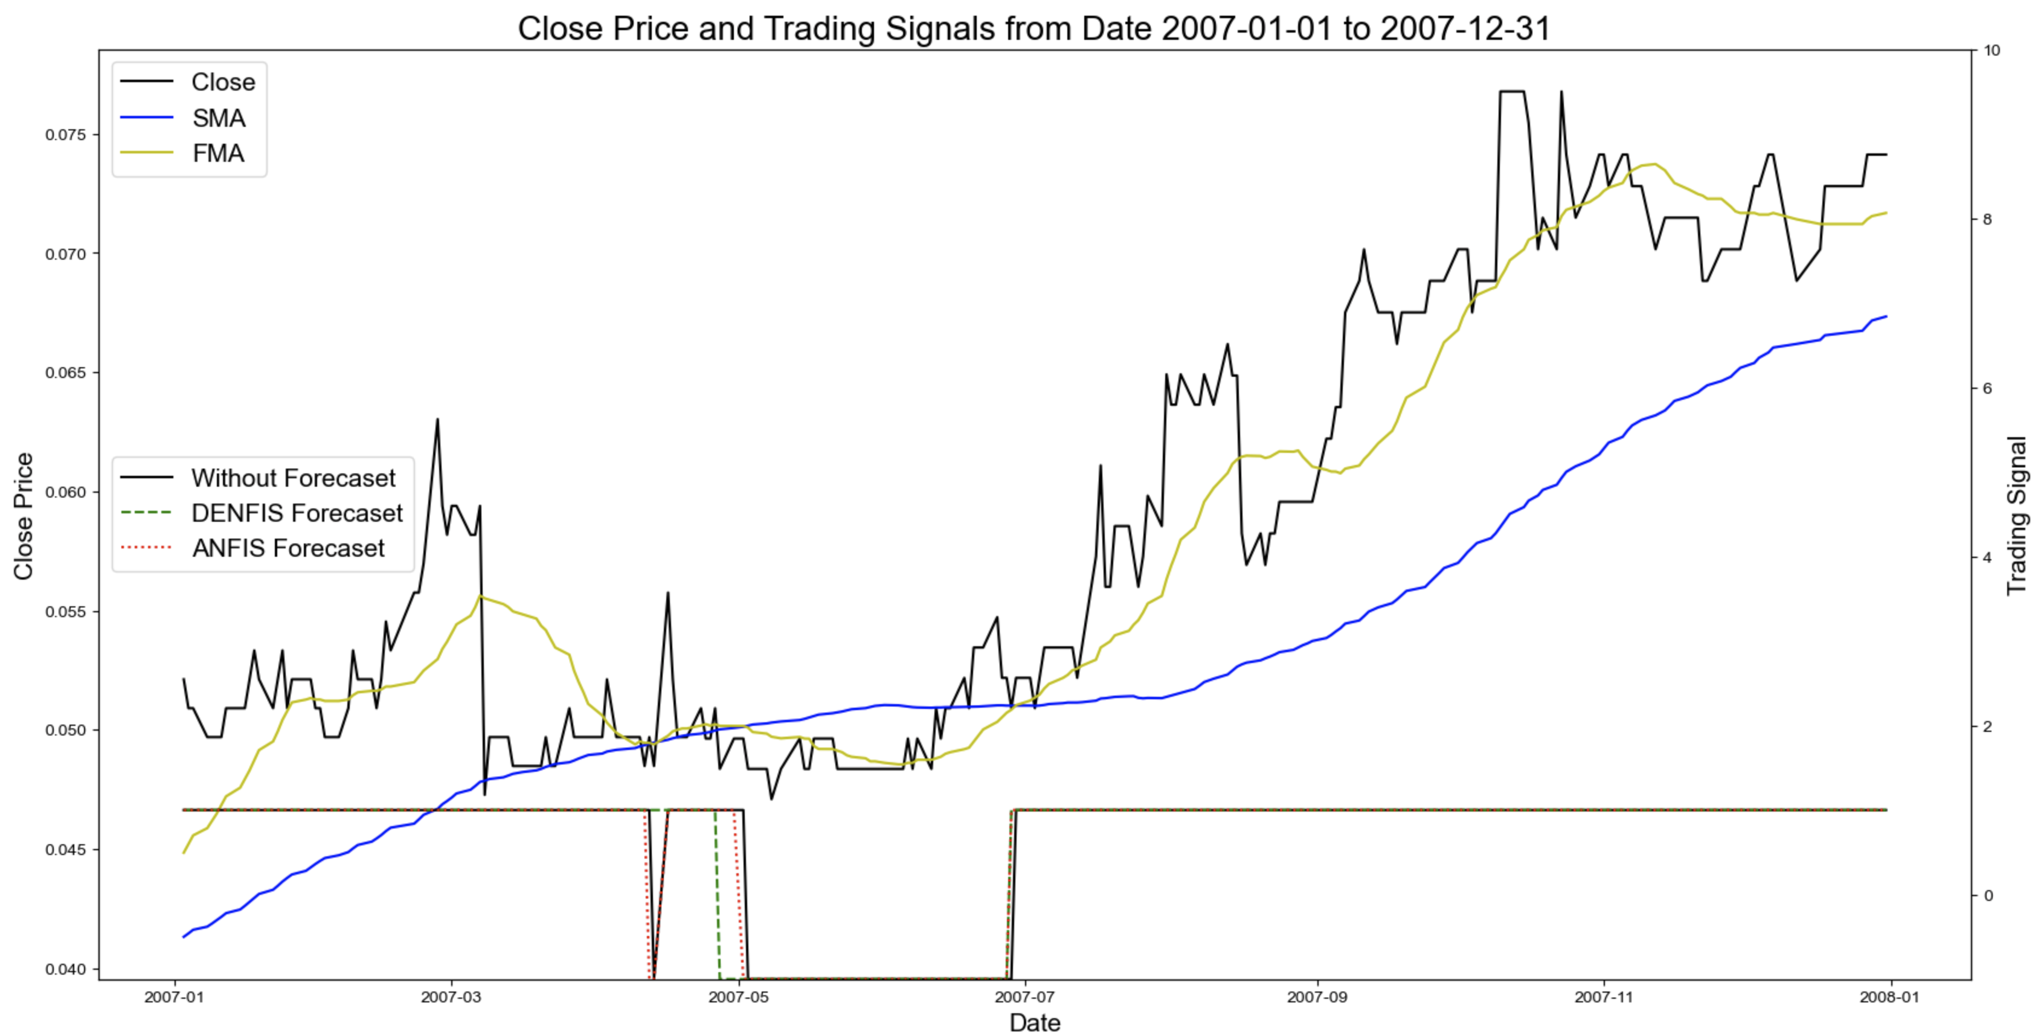
Results

Slide 14
References
Nikola K. and Qun Song, “DENFIS: Dynamic Evolving Neural-Fuzzy Inference System and Its Application for Time-Series Prediction”
R. Jang, “ANFIS: Adaptive Network-based Fuzzy Inference System”
Ang K. K. and Quek C., “Stock Trading Using RSPOP: A Novel Rough Set-Based Neuro-Fuzzy Approach”
ANFIS Code: https://github.com/gregorLen/AnfisTensorflow2.0

